Slide 1
- ISLAMIC ART COMPETITION

Slide 2
Opportunity for both Muslims and Non-Muslims students to display their art skills

Slide 3
Art work should be made according to the following rules:
Art projects can also be made from wood, clay, tiles and different materials
The poster should be of A4 or A3 size

Slide 4
Although there may be human figures, drawing their facial features should be avoided.

Slide 5
Following are the topics which you can choose from to take part in this contest Islamic calligraphy

Slide 6
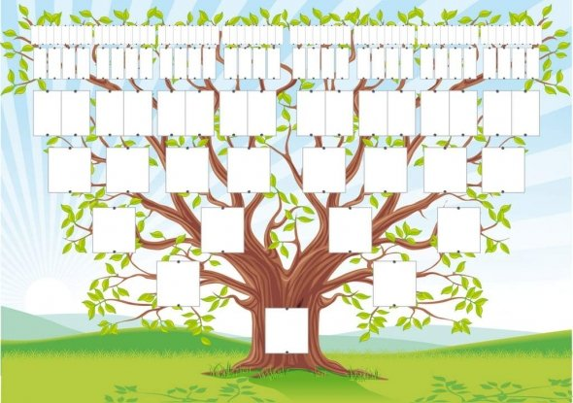
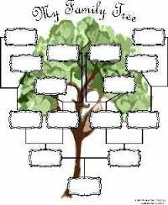
Family trees
Of Prophet Mohammad (P.B.U.H) or any other Prophet.

Slide 7
3D models of mosques

Slide 8
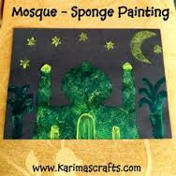
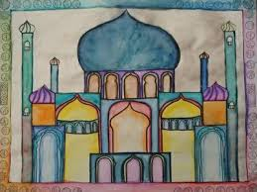
Painting of Mosques

Slide 9
Mosques made with blocks (Lego)

Slide 10
Drawings about Islamic facts Pillars of Islam

Slide 11
Pillars of Iman

Slide 12
Steps of Hajj

Slide 13
The students need to submit their art work to Mrs. Madiha or their class teacher before or on 22th January 2017. (that’s two weeks from now)

Slide 14
All the students who will participate will be given certificates and the best entries will be awarded with a prize in assembly.

